Slide 1
CHEM DSE 202
SECTION B
GROUP 14
CARBON FAMILY

Slide 2
Topics Covered
Allotropic forms of cabon
Fullerenes
Carbides of Calcium and Silicon
Diagonal relation group 13 and 14
Basic questions

Slide 3
Group 14
Carbon C 2s² 2p²
Silicon Si 3s² 3p²
Germanium Ge 4s² 4p²
Tin Sn 5s² 5p²
Lead Pb 6s² 6p²

Slide 4
Allotropic forms
All elements of group 14 show allotropy except Lead .
Carbon exists in Diamond ,graphite form and fullerenes.
Elemental silicon exists in only diamond form due to its large size and poor tendendency to form p-p bonds.
Germanium in Diamond form and tin in diamond and metallic form
Lead exists only in metallic form,so no allotropy.

Slide 5
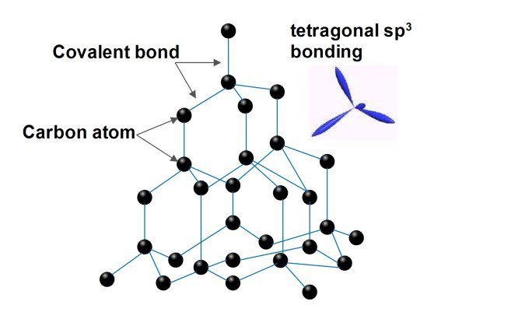
Allotropes of Carbon
Diamond form
Diamond form :
Each carbon atom is sp3 hybridised and attached to four other carbon atoms in tetrahedral form.
So a 3D network solid is formed in diamond.

Slide 6
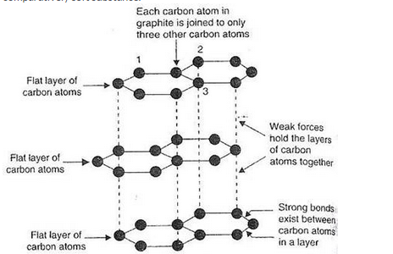
Allotropes of Carbon
Graphite form
Graphite form:Each carbon is sp² hybridised and is linked to three other carbon atoms by three single covalent bonds forming hexagonal layers.
The unhybridised p orbital on each carbon forms pi bond .
The distance between layers is large and the layers are held together by weak Vanderwaal forces.

Slide 7
Allotropes of Carbon : Fullerene
A fullerene is an allotrope of carbon whose molecule consists of carbon atoms connected by single and double bonds so as to form a closed or partially closed mesh, with fused rings of five to seven atoms.
The molecule may be a hollow sphere, ellipsoid, tube, or many other shapes and sizes. Graphene (isolated atomic layers of graphite), which is a flat mesh of regular hexagonal rings, can be seen as an extreme member of the family.
Fullerenes with a closed mesh topology are informally denoted by their empirical formula C_{n}, often written Cn, where n is the number of carbon atoms

Slide 8
Fullerenes
Named after buckminsterfullerene (C₆₀), the most famous member, which in turn is named after Buckminster Fuller,a famous architect.
The closed fullerenes, especially C₆₀, are also informally called buckyballs for their resemblance to the standard ball of association football ("soccer").
Nested closed fullerenes have been named bucky onions. Cylindrical fullerenes are also called carbon nanotubes or buckytubes.
The bulk solid form of pure or mixed fullerenes is called fullerite.
Kroto, Curl, and Smalley were awarded the 1996 Nobel Prize in Chemistry for their roles in the discovery of this class of molecules.

Slide 9
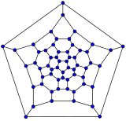
Simplest fullerene C₆₀
Buckminsterfullerene is the smallest fullerene molecule containing pentagonal and hexagonal rings in which no two pentagons share an edge (which can be destabilizing, as in pentalene). It is also most common in terms of natural occurrence, as it can often be found in soot.
The empirical formula of buckminsterfullerene is C₆₀ and its structure is a truncated icosahedron, which resembles an association football ball of the type made of twenty hexagons and twelve pentagons, with a carbon atom at the vertices of each polygon and a bond along each polygon edge.
Truncated Icosahedron
The van der Waals diameter of a buckminsterfullerene molecule is about 1.1 nanometers (nm). The nucleus to nucleus diameter of a buckminsterfullerene molecule is about 0.71 nm.

Slide 10
Carbides of Calcium & Silicon
Compounds of carbon with less electronegative elements are called carbides.
Carbides are of three types:
Covalent carbides
Ionic carbides
Interstitial carbides.

Slide 11
Covalent carbides
These carbides contain carbon covalently bonded to elements having electronegativity similar to carbon or with elements having higher electronegativity.
Two important covalent carbides are :
Silicon carbide and boron carbide.
SiC is used as abrasive and B₄C being harder

Slide 12
SILICON CARBIDE
It is also known as Carborundum and has formula SiC
Preparation: It is prepared by heating a mixture of coke and silicon dioxide in electric furnace at 2000-2500 ⁰C
SiO₂ + 2C Si + 2CO
Si + C SiC
It can also be prepared by passing acetylene on heated silicon.
2Si + C₂H₂ 2SiC + H₂

Slide 13
Properties of SiC (Carborundum)
It is a colourless covalent compound .It is hard as diamond .
It is widely used as an abrasive called Carborundum.
It reacts with sodium hydroxide in presence of oxygen
SiC + 4NaOH +2O₂ Na₂CO₃+Na₂SiO₃+2H₂O
It reacts with elemental chlorine to give silicon tetrachloride at 100 C
SiC + 2Cl₂ SiCl₄

Slide 14
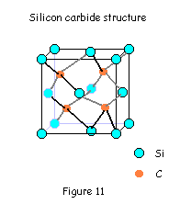
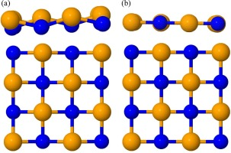
Structure of SiC 3d and 2D
It has a three dimensional network of silicon and carbon atoms .Each carbon and silicon atom is tetrahedrally surrounded by silicon and carbon respectively i.e each carbon by four silicon and each silicon by four carbon.
The tetrahedral structure is similar to diamond and therefore it is as hard as diamond

Slide 15
IONIC CARBIDES
Methanides
Be₂C
On hydrolysis give methane
Acetyllides
CaC₂
On hydrolysis give acetylene
Allylides
Mg₂C₃
On hydrolysis give propyne
Al₄C₃
Contains C⁴⁻ ion
Contains C₂²⁻ ion
Contains C₃²⁻ ion

Slide 16
Calcium Carbide
It is an ionic carbide under the category acetylides
Preparation:By heating lime with coke in a furnace
CaO + C CaC₂ + CO
Properties :
It gives acetylene on hydrolysis.
CaC₂ +2H₂O C₂H₂ + Ca(OH)₂
With nitrogen it gives calcium cyanamide, a fertiliser
CaC₂ + N₂ CaNCN + C

Slide 17
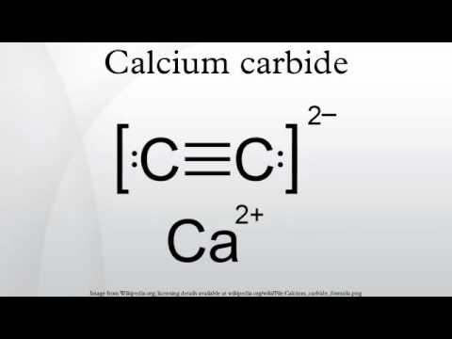
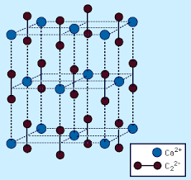
STRUCTURE OF CaC₂

Slide 18
Diagonal relation between B(Group 13) &Si(Group 14)
Li Be B C Second Period
Na Mg Al Si Third Period
The above relationship between Li and Mg; Be and Al ; B and Si is diagonal relationship
The basic cause of this relationship is similarity in the properties of the elements of second period with elements to their lower right in third period .
This similarity arises because two opposing tendencies along period and group cancel each other diagonally and hence becomes same.

Slide 19
Diagonal relationship Concept
Decreasing electropositive character PERIOD (LEFT TO RIGHT)
10 9 8 7 6 5
11 10 9 8 7 6
12 11 10 9 8 7
Diagonally the electropositive character
remains same
INCREASING
Eletro +
Character
Along GROUP
TOP TO BOTTOM

Slide 20
Similarities between B and Si
Both are non metals with high m.pt and b.pt
Both exist in allotropic forms
Both form hydrides called boranes and silanes respectively which catch fire spontaneously.
Both form weak acids H₃BO₃ and H₂SiO₃
Halides of both fume in moist air
BCl₃+ H₂O B(OH)₃ + 3HCl
Carbides of both B₄C and SiC are hard and used as abrasive

Slide 21
Some basic questions : Group 14
CO₂ is a gas and SiO₂ is a solid
Hint: CO2 is discrete molecule with pi bonding,SiO2 is giant molecule with sigma bonding
CCl₄ cannot be hydrolysed,SiCl₄ can be hydrolysed.
Hint: Si has vacant d orbital in valence shell where nucleophilic attack of water can occur.
C and Si are tetravalent while Ge,Sn,Pb show divalency
Hint:Inert pair effect.
Write short note :
Dry ice ,Silicates , Teflon,Interstitial carbides.

Slide 22
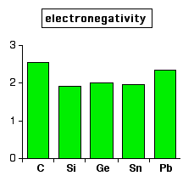
Comment on above diagram……….
Thank you with a hope that you will revise the questions of group 14 that you have studied in your lower classes.
Next topic: Group 15

